Slide 1
Design and Finite Element Modelling of
Stochastically Generated Composite Microstructures
BTech Project
on
Shardul Kher
^{Under Guidance of:}
^{Prof. Jaya Balila}

Slide 2
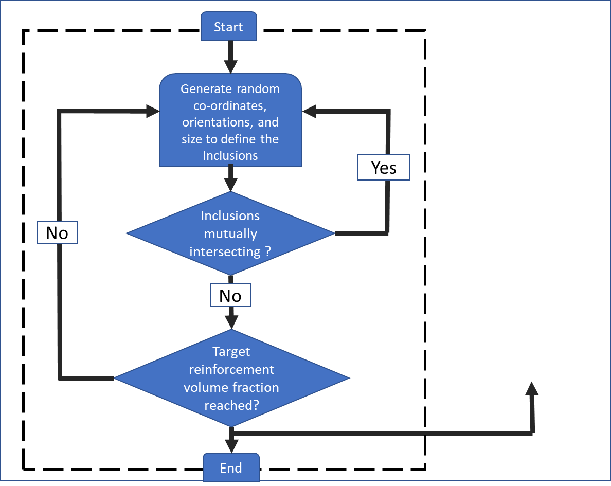
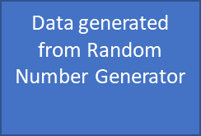
Algorithm Used
Credits:
Hrushikesh Sahasrabuddhe

Slide 3
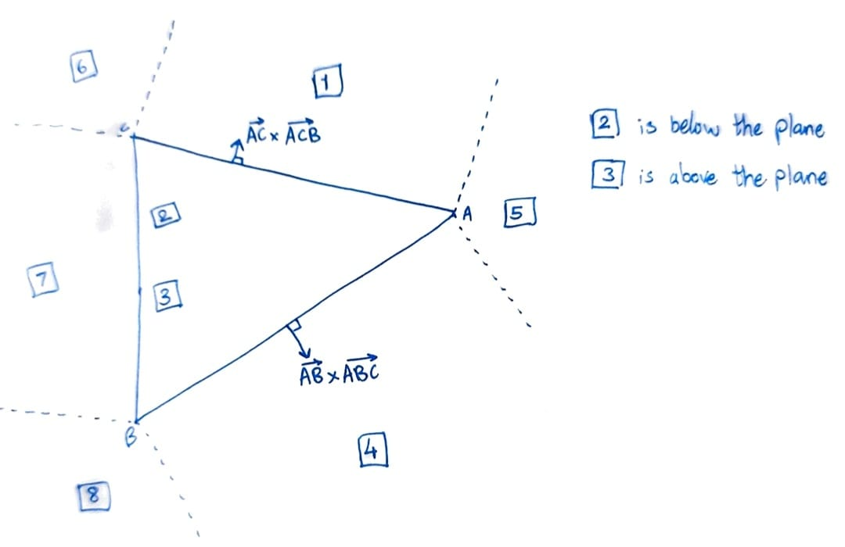
GJK Algorithm: 3D Implementation
Check if the origin is in or
2
3
The support vector for point D would be (ABC)
Latest point added to the simplex is D
if (ABC).DO > 0 ; origin is outside simplex
elif (ACD).DO > 0 ; origin outside simplex
elif (ADB).DO > 0 ; origin outside simplex
elif (BDC).DO > 0 ; origin outside simplex
If all the above are false,
This concludes if our simplex contains the origin (not the thing we desire though :/)

Slide 4



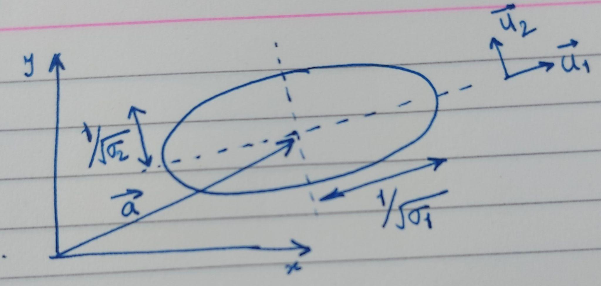
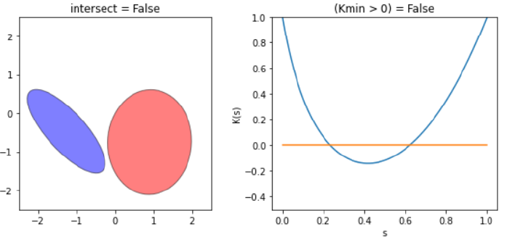
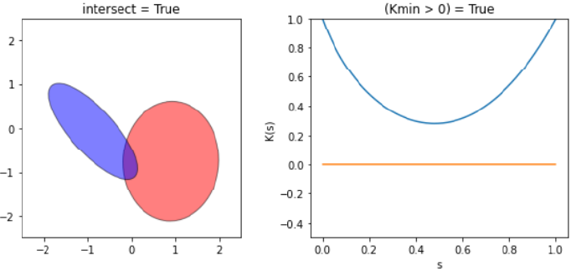
Intersecting Ellipsoids
, ellipsoids intersect

Slide 5
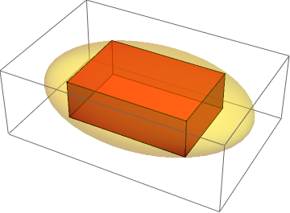
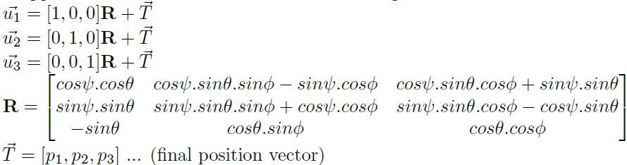

Cuboidal plates
l
b
w
Homogeneous Transformation is used to place the plates to desired locations and in appropriate orientation

Slide 6
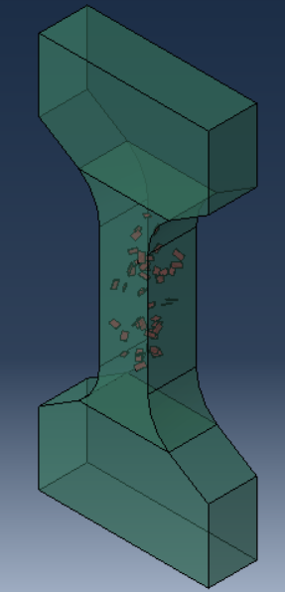
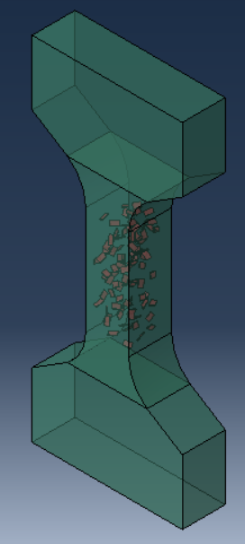
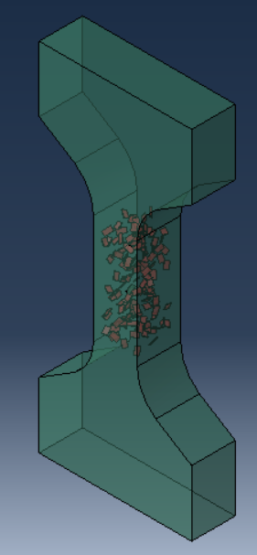
Cuboidal plates
1% Volume Fraction
2% Volume Fraction
3% Volume Fraction

Slide 7
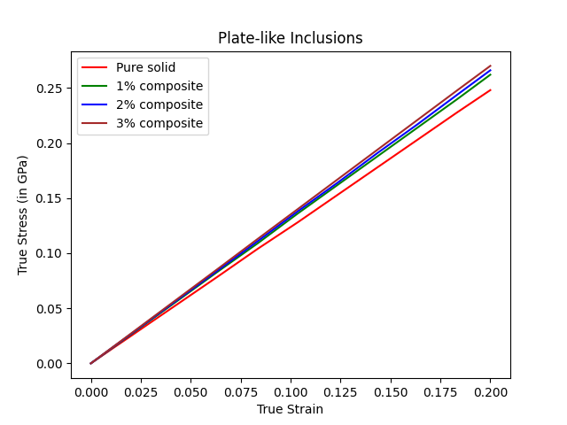
Cuboidal plates
f = 3% ; Ecomp = 1.35GPa ___(FEM)
f = 3% ; Ecomp = 1.295GPa ___(Analytical calculations)
%error = 4.07
f = 2% ; Ecomp= 1.33GPa ___(FEM)
f = 2% ; Ecomp = 1.262GPa ___(Analytical calculations)
%error = 5.11
f = 1% ; Ecomp = 1.31GPa ___(FEM)
f = 1% ; Ecomp = 1.250GPa ___(Analytical calculations)
%error = 4.58
Ref: Elastic moduli of composites containing a low concentration of complex-shaped particles having a general property contrast with the matrix; E.J. Garboczi, J.F. Douglas; Mechanics of Materials; Elsevier

Slide 8
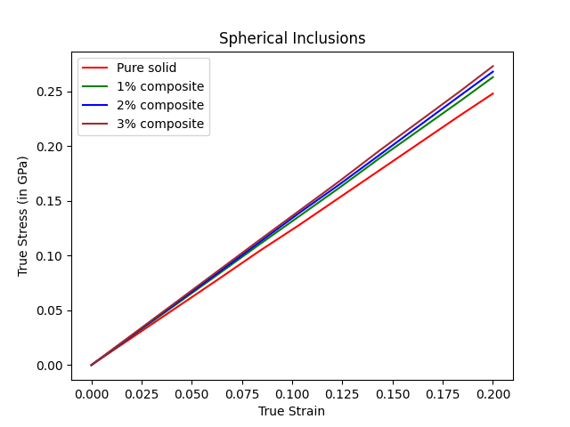
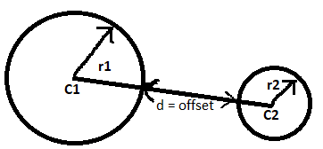
Spheres
For the spheres to not coalesce:
dist(C1,C2) > r1+r2+offset

Slide 9
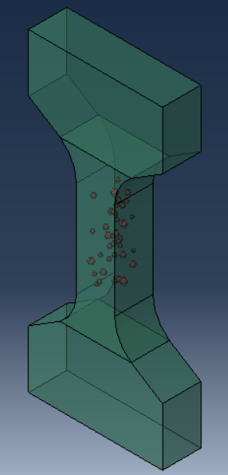
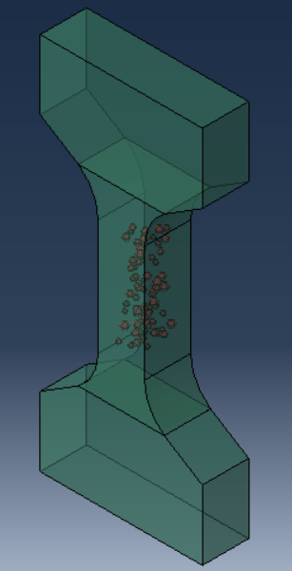
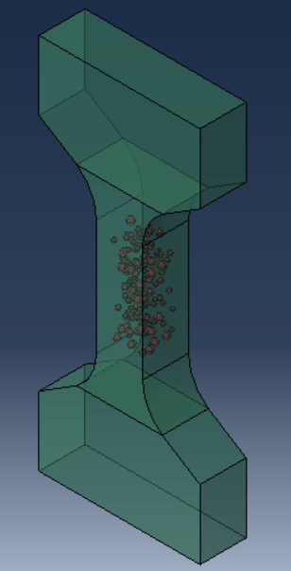
Spheres
1% Volume Fraction
2% Volume Fraction
3% Volume Fraction

Slide 10
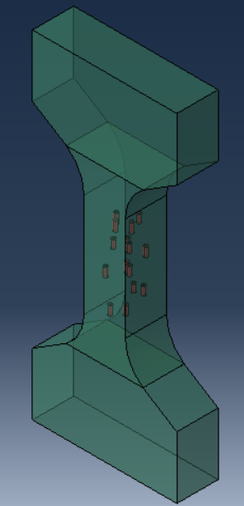
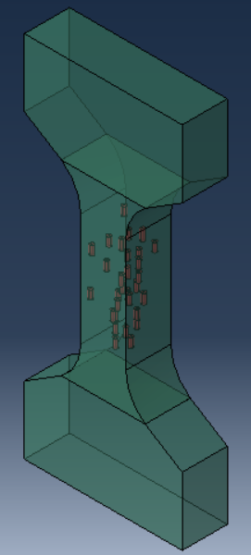
Fibers along the tensile direction
1% Volume Fraction
2% Volume Fraction

Slide 11
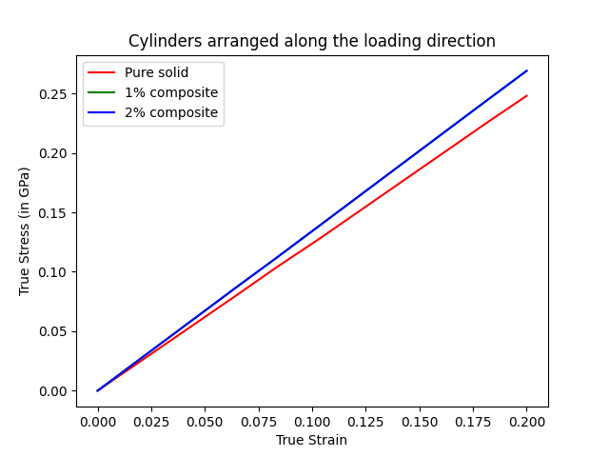
Fibers along the tensile direction
f = 2% ; Ecomp= 1.345GPa ___(FEM averaged out)
f = 2% ; Ecomp= 2.022GPa ___(Analytical calculations)
f = 1% ; Ecomp = 1.345GPa ___(FEM averaged out)
f = 1% ; Ecomp = 2.043GPa ___(Analytical calculations)

Slide 12
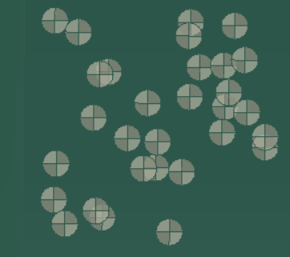
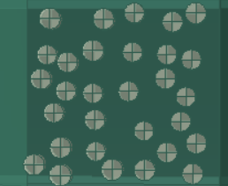
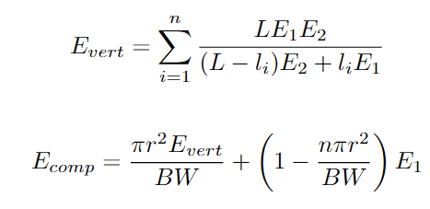
Fibers along the tensile direction
Assumption: No fiber lies in the circumference of another
Could assume long fibers having li length of E2 and L-li length of E1
Prediction by hand calculations > FEM
∵ Evert (2) > Evert (1)
The predicted model shows results close to that from FEM
(1) Actual arrangement of fibers
(2) Assumed arrangement to calculate analytically

Slide 13
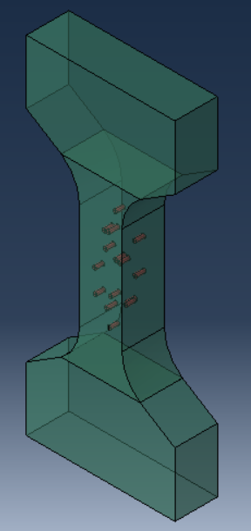
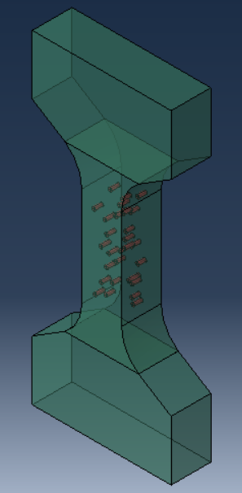
Fibers perpendicular to the tensile direction
1% Volume Fraction
2% Volume Fraction

Slide 14
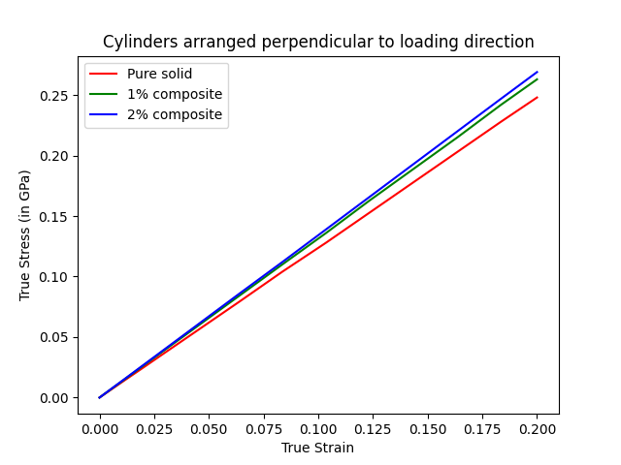
Fibers perpendicular to the tensile direction

Slide 15
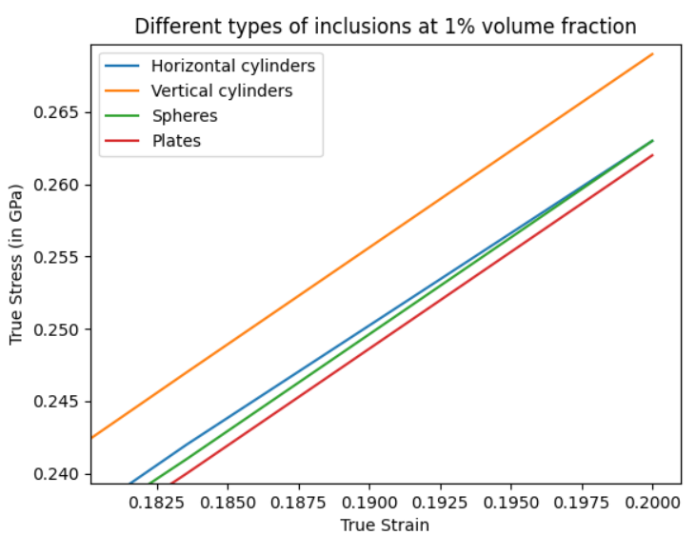
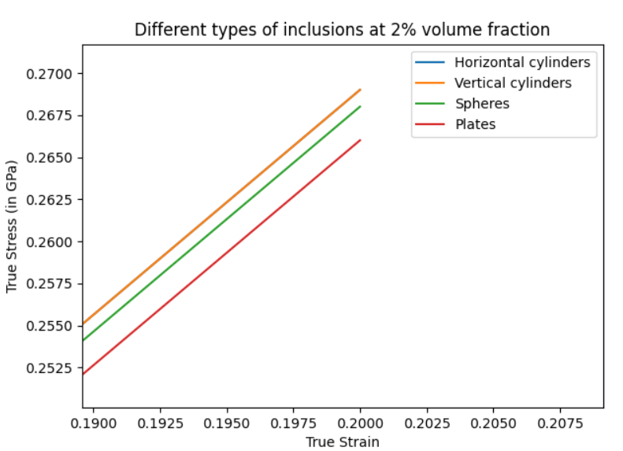
Conclusion

Slide 16
Conclusion
Composites having fibers lying in isostrain fashion show the highest increase in the modulus.

Slide 17
Why was this important?
To study crack propagation in fiber reinforced ceramics. Fiber spacing, their diameters can be varied and the results be observed
To study the mechanical properties of high-performance particle-reinforced composites with different inclusion volume fraction, having various shapes and orientations inside the matrix

Slide 18
References
[1] Effective elastic properties of composites with particles of polyhedral shapes; Anton Trofimov, Borys Drach, Igor Sevostianov; International Journal of Solids and Structures
[2] A Robust Computational Test for Overlap of Two Arbitrary-dimensional Ellipsoids in Fault-Detection of Kalman Filters; Igor Gilitschenski and Uwe D. Hanebeck
[3] Monte Carlo simulation for exploring the mechanical properties of particle-reinforced composites based on the scale boundary finite element method; KuiYu Zhao, Ran Guo, GuangYing Liu, YuHong Li; Composite Structures; Elsevier
[4] Predicting the effects of microstructure on matrix crack initiation in fiber
reinforced ceramic matrix composites via machine learning; Dipen K. Patela, Triplicane Parthasarathy, Craig Przybyla; Composite Structures; Elsevier

Slide 19
Thank You!

